Slide 1
عمادة التطوير والجودة
Deanship of Development and Quality
وحدة التدريب والتطوير
عنوان الدورة
مقدم الدورة
قالب دورة تدريبية

Slide 2
محاور الدورة
01.
Insert A Content Name
Fill in the following text fields with appropriate explanations.
02.
Insert A Content Name
Fill in the following text fields with appropriate explanations.
03.
Insert A Content Name
Fill in the following text fields with appropriate explanations.
04.
Insert A Content Name
Fill in the following text fields with appropriate explanations.
05.
Insert A Content Name
Fill in the following text fields with appropriate explanations.

Slide 3
صفحة محتوى
Presentation is a public speaking activity that aims to convey a message or information.
The things conveyed can be in the form of ideas, ideas, programs, products, or services
and are usually carried out in a discussion or forum. A good presentation must contain
at least three important aspects which include opening, content and conclusion.
Presentation is a public speaking activity that aims to convey a message or information.
The things conveyed can be in the form of ideas, ideas, programs, products, or services
and are usually carried out in a discussion or forum.

Slide 4
نموذج محتوى
عنوان فرعي
Presentation is a public speaking activity that aims to convey a
message or information. The things conveyed can be in the form
of ideas, ideas, programs, products, or services and are usually
carried out in a discussion or forum. A good presentation must
contain at least three important aspects which include opening,
content and conclusion.
Content Name
Content Name
Fill in the following text
fields with appropriate
explanations.
Fill in the following text
fields with appropriate
explanations.

Slide 5
عنوان
Presentation is a public speaking activity that aims to convey a message or
information. The things conveyed can be in the form of ideas, ideas, programs,
products, or services and are usually carried out in a discussion or forum. A
good presentation must contain at least three important aspects which include
opening, content and conclusion.
محتوى
محتوى
محتوى
محتوى
Presentation is a public
speaking activity that aims
to convey a message
or information. The things
conveyed can be in the form
of ideas, ideas, programs,
products, or services and are
usually carried out in a
discussion or forum.
Presentation is a public
speaking activity that aims
to convey a message
or information. The things
conveyed can be in the form
of ideas, ideas, programs,
products, or services and are
usually carried out in a
discussion or forum.
Presentation is a public
speaking activity that aims
to convey a message
or information. The things
conveyed can be in the form
of ideas, ideas, programs,
products, or services and are
usually carried out in a
discussion or forum.
Presentation is a public
speaking activity that aims
to convey a message
or information. The things
conveyed can be in the form
of ideas, ideas, programs,
products, or services and are
usually carried out in a
discussion or forum.

Slide 6
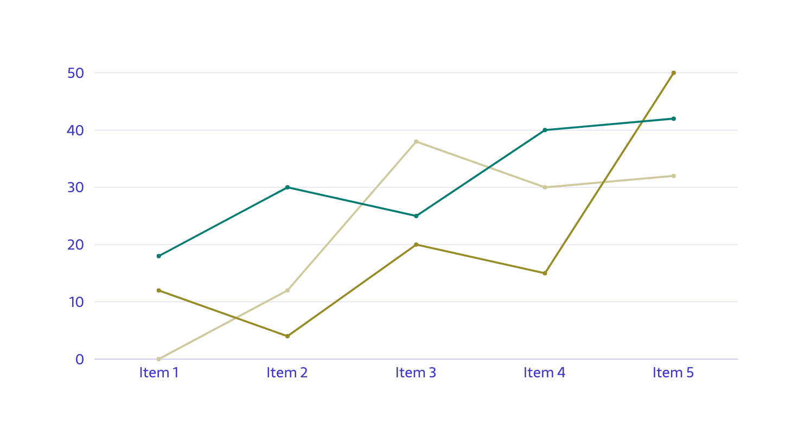
عنوان
Presentation is a public speaking activity that aims to
convey a message or information. The things conveyed
can be in the form of ideas, ideas, programs, products, or
services and are usually carried out in a discussion or forum.
محتوى
Fill in the following text
fields with appropriate
explanations.
محتوى
Fill in the following text
fields with appropriate
explanations.
محتوى
Fill in the following text
fields with appropriate
explanations.

Slide 7
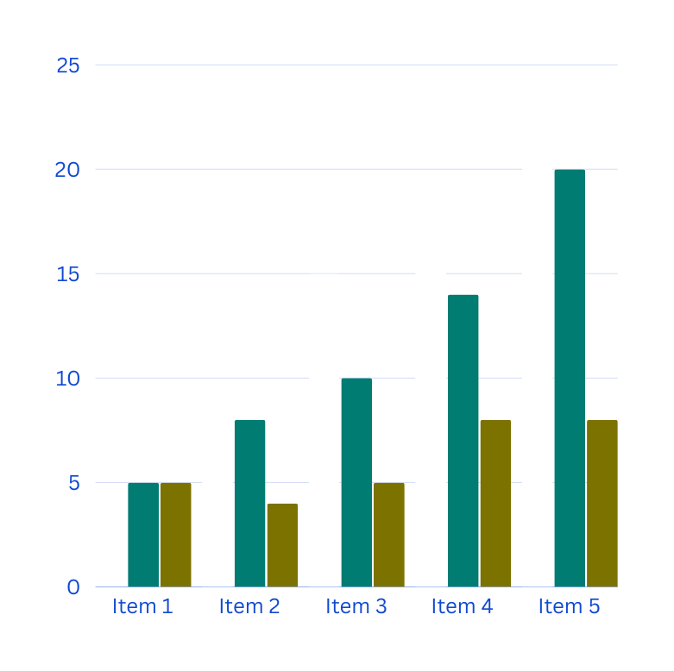
محتوى
عنوان
Fill in the following text
fields with appropriate
explanations.
محتوى
Presentation is a public speaking
activity that aims to convey a
message or information. The
things conveyed can be in the
form of ideas, ideas, programs,
products, or services and are
usually carried out in a
discussion or forum.
Fill in the following text
fields with appropriate
explanations.
محتوى
Fill in the following text
fields with appropriate
explanations.

Slide 8
محتوى
Presentation is a public speaking activity that aims to convey a message
or information. The things conveyed can be in the form of ideas, ideas,
programs, products, or services and are usually carried out in a discussion
or forum. A good presentation must contain at least three important
aspects which include opening, content and conclusion.
Presentation is a public speaking activity that aims to convey a message
or information. The things conveyed can be in the form of ideas, ideas,
programs, products, or services and are usually carried out in a discussion
or forum. A good presentation must contain at least three important
aspects which include opening, content and conclusion.
+123-456-7890
www.reallygreatsite.com
123 Anywhere St., Any City

Slide 9
%
%
%
عنوان
Content Name
Content Name
Content Name
Presentation is a public speaking
activity that aims to convey a
message or information. The
things conveyed can be in the
form of ideas, ideas, programs,
products, or services and are
usually carried out in a
discussion or forum.
محتوى
Content Name
2023
2023
2023
Increase
Description
123
231
312
%
Description
123
231
312
%
Description
123
231
312
%
Description
123
231
312
%

Slide 10
THANK
YOU
The things conveyed can be in the form of ideas, ideas,
programs, products, or services and are usually carried
out in a discussion or forum. A good presentation must
contain at least three important aspects which include
opening, content and conclusion.

