Slide 1
عمادة التطوير والجودة
Deanship of Development and Quality
وحدة التدريب والتطوير
عنوان الدورة
مقدم الدورة
قالب دورة تدريبية

Slide 2
عنوان
Presentations are communication tools that can be used as demonstrationsand more.
Presentations are communication tools that can be used as demonstrations, lectures, speeches, reports, and more.
Presentations are communication tools that can be used as demonstrationsand more.
Presentations are communication tools.

Slide 3
محتوى
محتوى
Presentations are communication tools that can be used as demonstrations, lectures, speeches, reports, and more.
Presentations are communication tools that can be used as demonstrations, lectures, speeches, reports, and more.
Presentations are communication tools that can be used as demonstrations.
Presentations are communication tools that can be used as demonstrations.
Presentations are communication tools
that can be used as demonstrations.
Presentations are communication tools
that can be used as demonstrations.

Slide 4
عنوان
Presentations are communication tools that can be used as demonstrations, lectures, speeches, reports, and more. Presentations are communication tools that can be used as demonstrations. Presentations are communication tools that can be used as demonstrations, lectures, speeches, reports, and more. Presentations are communication tools that can be used as demonstrations, lectures, speeches, reports, and more.
Presentations are communication tools
that can be used as demonstrations.

Slide 5
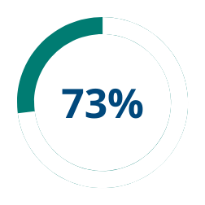
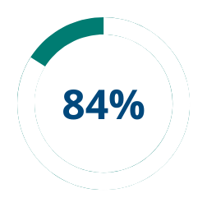
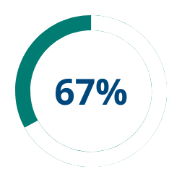
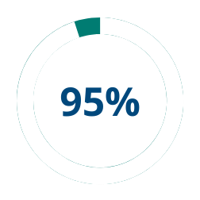
عنوان
Presentations
are communication tools that can be used as demonstrations, lectures, speeches, reports, and more.
Presentations
are communication tools that can be used as demonstrations, lectures, speeches, reports, and more.
Presentations
are communication tools that can be used as demonstrations, lectures, speeches, reports, and more.
Presentations
are communication tools that can be used as demonstrations, lectures, speeches, reports, and more.

Slide 6
2025
Presentations
are communication tools that can be used as demonstrations, lectures, speeches, and more.
Presentations
are communication tools that can be used as demonstrations, lectures, speeches, and more.
2024
Presentations
are communication tools that can be used as demonstrations, lectures, speeches, and more.
Presentations
are communication tools that can be used as demonstrations, lectures, speeches, and more.
2023
2022
Presentations
are communication tools that can be used as demonstrations, lectures, speeches, and more.
Presentations
are communication tools that can be used as demonstrations, lectures, speeches, and more.
2021
Presentations
are communication tools that can be used as demonstrations, lectures, speeches, and more.
Presentations
are communication tools that can be used as demonstrations, lectures, speeches, and more.
START

Slide 7
محتوى
محتوى
محتوى
محتوى
01
Presentations are communica-
tion tools that can be used as demonstrations, lectures
and more.
Presentations are communica-
tion tools that can be used as demonstrations, lectures
and more.
Presentations are communica-
tion tools that can be used as demonstrations, lectures
and more.
عنوان
-
02
Presentations are communica-
tion tools that can be used as demonstrations, lectures
and more.
Presentations are communica-
tion tools that can be used as demonstrations, lectures
and more.
Presentations are communica-
tion tools that can be used as demonstrations, lectures
and more.
Presentations are communica-
tion tools that can be used as demonstrations, lectures
and more.
Presentations are communication tools that can be used as demonstrations, lectures, speeches, reports, and more.
03
Presentations are communica-
tion tools that can be used as demonstrations, lectures
and more.
Presentations are communica-
tion tools that can be used as demonstrations, lectures
and more.
-
Presentations are communica-
tion tools that can be used as demonstrations, lectures
and more.
04
-
Presentations are communica-
tion tools that can be used as demonstrations, lectures
and more.
Presentations are communica-
tion tools that can be used as demonstrations, lectures
and more.
-

Slide 8
01
Presentations are communication
عنوان
tools that can be used as demonstrations, lectures, speeches, reports, and more.
Presentations are communication
02
tools that can be used as demonstrations, lectures, speeches, reports, and more.
Presentations are communication tools that can be used as demonstrations, lectures, speeches, reports, and more.
03
Presentations are communication
tools that can be used as demonstrations, lectures, speeches, reports, and more.
Presentations are communication tools that can be used as demonstrations.
Presentations are communication
04
tools that can be used as demonstrations, lectures, speeches, reports, and more.
Presentations are communication tools that can be used as demonstrations, lectures, speeches,and more.
05
Presentations are communication
tools that can be used as demonstrations, lectures, speeches, reports, and more.
Presentations are communication tools
that can be used as demonstrations.
Presentations are communication

Slide 9
عنوان
عنوان فرعي
عنوان فرعي
عنوان فرعي
Presentations are communication tools that can be used as demonstrations, lectures, speeches, reports, and more.
Presentations are communication tools that can be used lectures, speeches, reports, and more.
Presentations are communication tools that can be used as lectures, speeches, and more.
Presentations are communication tools that can be used as lectures, speeches,demonstrations,and more.
Presentations are communication tools that can be used as demonstrations, lectures, speeches, reports, and more.
Presentations are communication tools that can be used as lectures, speeches, and more.
Presentations are communication tools that can be used reports.
Presentations are communication tools that can be used reports.
Presentations are communication tools that can be used reports.

Slide 10
عنوان
محتوى
Presentations are communication
tools that can be used as demonstrations, lectures, speeches, reports, and more.
محتوى
Presentations are communication
tools that can be used as demonstrations, lectures, speeches, reports, and more.
محتوى
Presentations are communication
tools that can be used as demonstrations, lectures, speeches, reports, and more.
Presentations are communication
محتوى
tools that can be used as demonstrations, lectures, speeches, reports, and more.

Slide 11
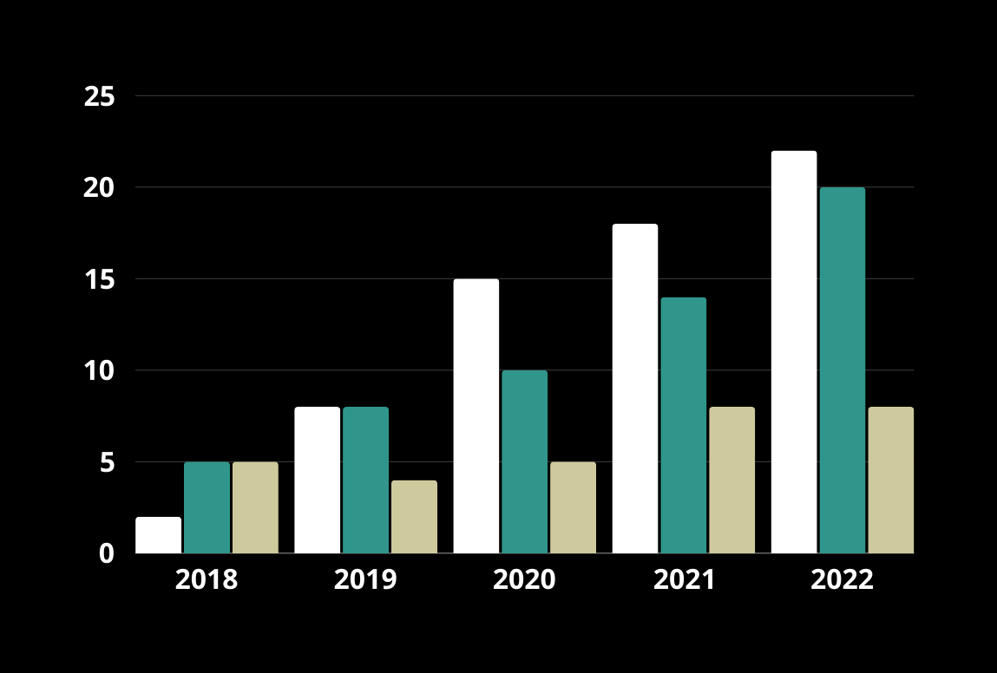
عنوان

Slide 12
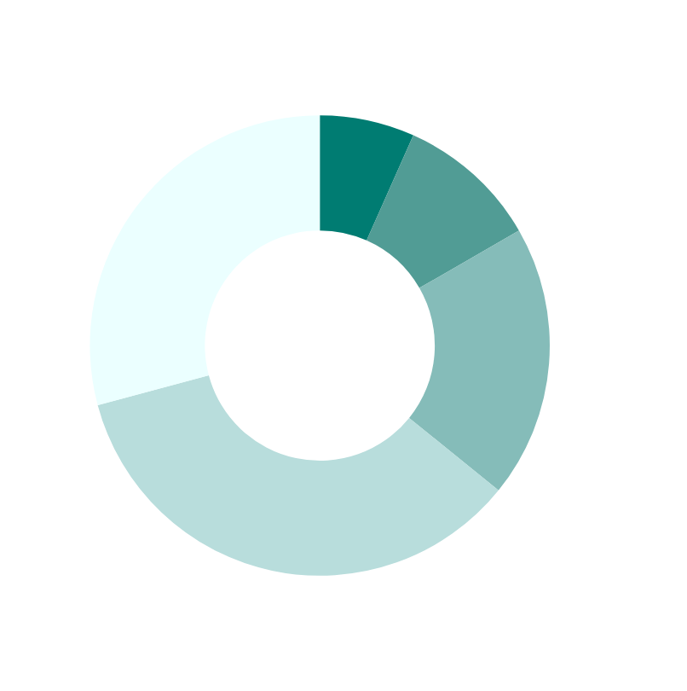
عنوان
Presentations are communication tools that can be used as demonstrations, lectures, speeches, reports, and more.
Presentations are communication tools that can be used as demonstrations.
Presentations are communication tools
that can be used as demonstrations.

Slide 13
Thank You
Presentations are communication tools
Presentations are communication tools that can be used as demonstrations, lectures, speeches, reports, and more.

