Slide 1
عمادة التطوير والجودة
Deanship of Development and Quality
وحدة التدريب والتطوير
عنوان الدورة
مقدم الدورة
قالب دورة تدريبية

Slide 2
نموذج محتوى
Presentations are communication tools that can be used as demonstrationsand more.
Presentations are communication tools that can be used as demonstrations, lectures, speeches, reports, and more.
Presentations are communication tools that can be used as demonstrationsand more.
Presentations are communication tools.

Slide 3
العنوان هنا
العنوان هنا
Presentations are communication tools that can be used as demonstrations, lectures, speeches, reports, and more.
Presentations are communication tools that can be used as demonstrations, lectures, speeches, reports, and more.
Presentations are communication tools that can be used as demonstrations.
Presentations are communication tools that can be used as demonstrations.
Presentations are communication tools
that can be used as demonstrations.
Presentations are communication tools
that can be used as demonstrations.

Slide 4
صفحة محتوى
Presentations are communication tools that can be used as demonstrations, lectures, speeches, reports, and more. Presentations are communication tools that can be used as demonstrations. Presentations are communication tools that can be used as demonstrations, lectures, speeches, reports, and more. Presentations are communication tools that can be used as demonstrations, lectures, speeches, reports, and more.
Presentations are communication tools
that can be used as demonstrations.

Slide 5
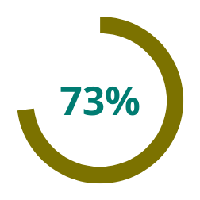
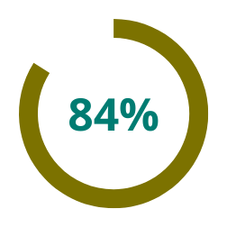
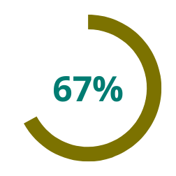
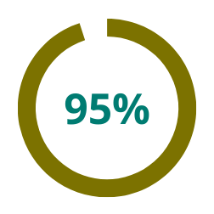
يمكن إضافة عنوان هنا
Presentations
are communication tools that can be used as demonstrations, lectures, speeches, reports, and more.
Presentations
are communication tools that can be used as demonstrations, lectures, speeches, reports, and more.
Presentations
are communication tools that can be used as demonstrations, lectures, speeches, reports, and more.
Presentations
are communication tools that can be used as demonstrations, lectures, speeches, reports, and more.

Slide 6
2022
Presentations
are communication tools that can be used as demonstrations, lectures, speeches, and more.
Presentations
are communication tools that can be used as demonstrations, lectures, speeches, and more.
2021
Presentations
are communication tools that can be used as demonstrations, lectures, speeches, and more.
Presentations
are communication tools that can be used as demonstrations, lectures, speeches, and more.
2020
2019
Presentations
are communication tools that can be used as demonstrations, lectures, speeches, and more.
Presentations
are communication tools that can be used as demonstrations, lectures, speeches, and more.
2017
Presentations
are communication tools that can be used as demonstrations, lectures, speeches, and more.
Presentations
are communication tools that can be used as demonstrations, lectures, speeches, and more.
START

Slide 7
محتوى
محتوى
محتوى
محتوى
01
Presentations are communica-
tion tools that can be used as demonstrations, lectures
and more.
Presentations are communica-
tion tools that can be used as demonstrations, lectures
and more.
Presentations are communica-
tion tools that can be used as demonstrations, lectures
and more.
Presentations are communication
tools
-
02
Presentations are communica-
tion tools that can be used as demonstrations, lectures
and more.
Presentations are communica-
tion tools that can be used as demonstrations, lectures
and more.
Presentations are communica-
tion tools that can be used as demonstrations, lectures
and more.
Presentations are communica-
tion tools that can be used as demonstrations, lectures
and more.
Presentations are communication tools that can be used as demonstrations, lectures, speeches, reports, and more.
03
Presentations are communica-
tion tools that can be used as demonstrations, lectures
and more.
Presentations are communica-
tion tools that can be used as demonstrations, lectures
and more.
-
Presentations are communica-
tion tools that can be used as demonstrations, lectures
and more.
04
-
Presentations are communica-
tion tools that can be used as demonstrations, lectures
and more.
Presentations are communica-
tion tools that can be used as demonstrations, lectures
and more.
-

Slide 8
01
Presentations are communication
إضافة عنوان هنا
tools that can be used as demonstrations, lectures, speeches, reports, and more.
Presentations are communication
02
tools that can be used as demonstrations, lectures, speeches, reports, and more.
Presentations are communication tools that can be used as demonstrations, lectures, speeches, reports, and more.
03
Presentations are communication
tools that can be used as demonstrations, lectures, speeches, reports, and more.
Presentations are communication tools that can be used as demonstrations.
Presentations are communication
04
tools that can be used as demonstrations, lectures, speeches, reports, and more.
Presentations are communication tools that can be used as demonstrations, lectures, speeches,and more.
05
Presentations are communication
tools that can be used as demonstrations, lectures, speeches, reports, and more.
Presentations are communication tools
that can be used as demonstrations.

Slide 9
عنوان هنا
عنوان فرعي
عنوان فرعي
عنوان فرعي
Presentations are communication tools that can be used as demonstrations, lectures, speeches, reports, and more.
Presentations are communication tools that can be used lectures, speeches, reports, and more.
Presentations are communication tools that can be used as lectures, speeches, and more.
Presentations are communication tools that can be used as lectures, speeches,demonstrations,and more.
Presentations are communication tools that can be used as demonstrations, lectures, speeches, reports, and more.
Presentations are communication tools that can be used as lectures, speeches, and more.
Presentations are communication tools that can be used reports.
Presentations are communication tools that can be used reports.
Presentations are communication tools that can be used reports.

Slide 10
عنوان هنا
محتوى
Presentations are communication
tools that can be used as demonstrations, lectures, speeches, reports, and more.
محتوى
Presentations are communication
tools that can be used as demonstrations, lectures, speeches, reports, and more.
محتوى
Presentations are communication
tools that can be used as demonstrations, lectures, speeches, reports, and more.
Presentations are communication
Presentations are communication tools
محتوى
tools that can be used as demonstrations, lectures, speeches, reports, and more.

Slide 11
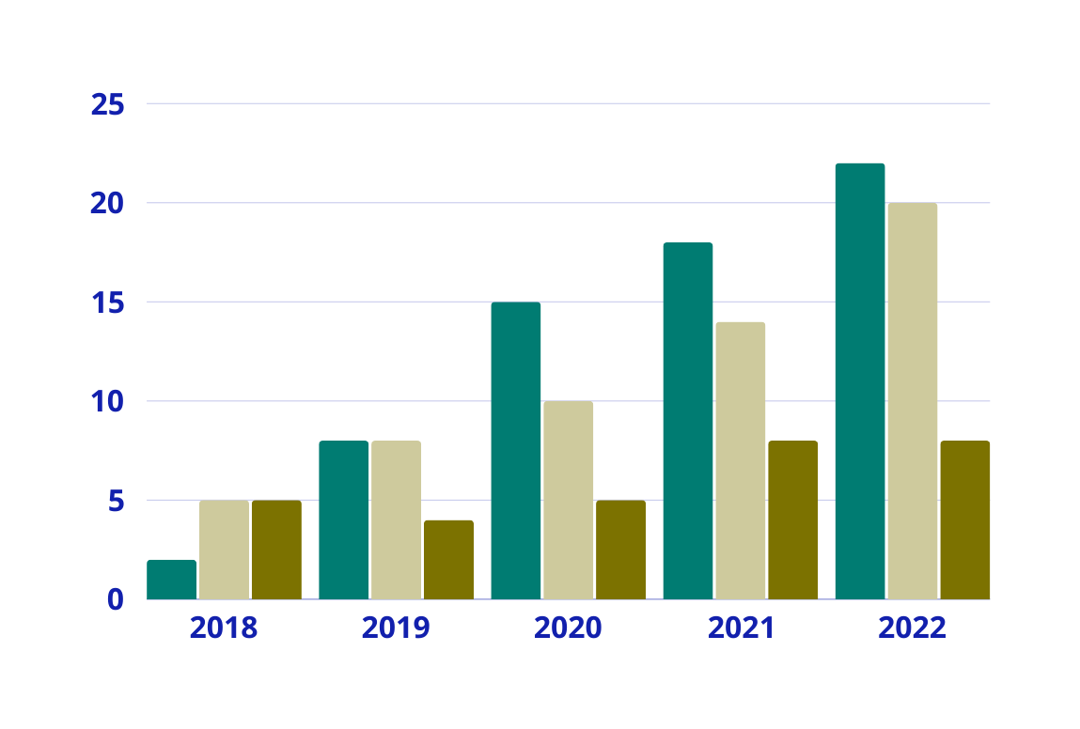
عنوان لرسم بياني

Slide 12
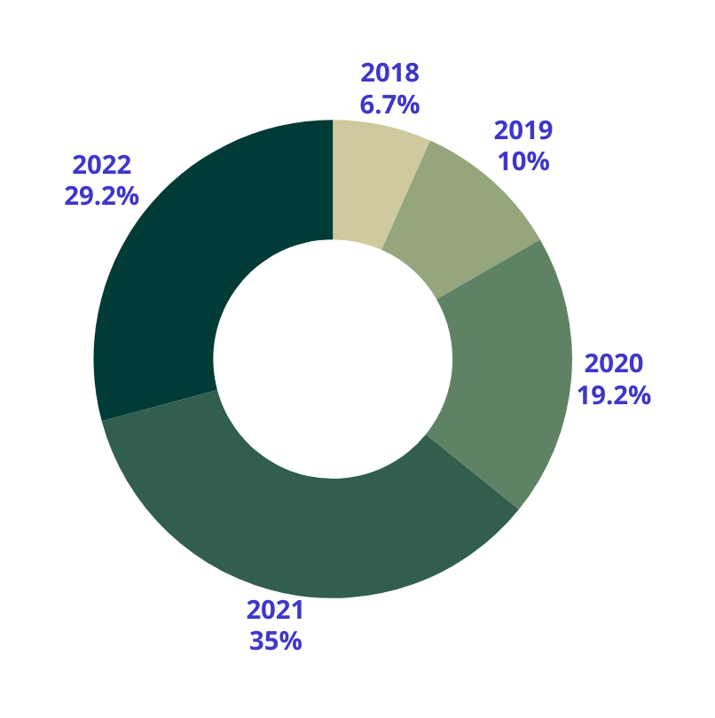
عنوان هنا
Presentations are communication tools that can be used as demonstrations, lectures, speeches, reports, and more.
Presentations are communication tools that can be used as demonstrations.
Presentations are communication tools
that can be used as demonstrations.

Slide 13
شكرا لكم
Presentations are communication tools
Presentations are communication tools that can be used as demonstrations, lectures, speeches, reports, and more.

